Slide 1

DEPARTMENT OF ELECTRICAL & ELECTRONICS ENGINEERING
SMART PARKING SYSTEM USING RASPBERRY PI AND RFID
GUIDE:
Sudharani Bhupathiraju M.Tech(Ph.D)
PROJECT MEMBERS:
GAVARA SATYA RAJESWARA RAO
19B95A0205
TANUKULA ARUN KUMAR
18B91A02J9
GORRELA CHANDU NAGA SUDHEER
19B95A0207
KODI DURGA VARA PRASAD
19B95A0215
THOKADA ABHISHEK
18B91A02K3
VELISALA NIVAS
18B91A02L8

Slide 2
CONTENTS
Abstract
Literature Survey
Introduction
Project Overview
Components
Working
Block Diagram
Connection Diagram
Prototype
Project Output
Conclusion
Future Scope
Reference

Slide 3
ABSTRACT
With the exponential increase in the number of vehicles and world population day by day, vehicle availability and usage on the road in recent years.
Finding a space for parking the car is becoming more and more difficult, resulting in the number of conflicts such as traffic problems.
This is about creating a reliable system that takes over the task of identifying free slots in a parking area and keeping the record of vehicles parked in a systematic manner.
This project focuses on decreasing the time wasted on discovering parking areas.

Slide 4
LITERATURE SURVEY
We have studied about some existing parking system and examined merits and demerits of existing parking system.
Multi Level floor Parking
In this type,vehicles are parked on different layers, floors of a building.These floors are accessed with the help of external or internal mediums such as ramps.
This arrangement helps to accommodate more cars and produce a faster parking process.
Advantages
● Maximum utilisation of ground space.
● Multiple safety guarantees of the drivers and cars
Disadvantages
●Expensive because the whole parking and retrieval operation is multilevel .
● Any fault in the multilevel car parking system causes great haphazard and inconvenience.

Slide 5
LITERATURE SURVEY
Parking Management System Based on Image Processing
The proposed system just uses image processing algorithms to automate the parking with footage obtained from the parking lot's surveillance cameras. These algorithms detect the empty parking spaces and convey the information to the drivers entering the parking premises.
Advantages
● A camera is used as a sensor to take photos to show the occupancy of car parks
● Single camera can detect the presence of many cars at once.
Disadvantages
The weather conditions affect the System i.e. in terms of visibility.
The camera should be in a position where it can see all the car parks and not be obstructed by any objects.

Slide 6
LITERATURE SURVEY
Automatic Parking Management System And Fee Collection Using Number Plate Recognition
ANPR cameras are used for capturing the licence number plates of the vehicle These ANPR cameras are more advantageous than other technologies. This system makes use of three cameras. Two cameras are used at entrance and exit respectively.
Advantages
● The auto parking system will have less interaction with humans and use magnetic cards and its devices.
● Licence plate recognition applies image processing and character recognition technology to identify vehicles by automatically reading the licence and its use for building.
Disadvantages
● Number plates differ in terms of colour, size and type from country to country. Different algorithms have to be applied for different types of number plates.
●No way a user can reserve a parking lot in advance

Slide 7
INTRODUCTION
The Internet-of- Things technology(IoT) has created a revolution in many ways in life as well as in smart parking system (SPS) technology.
As parking becomes a very essential need of our day to day life.
This proposed system looks forward to planning and acquiring a smart parking system before heading out towards our destination in order to reduce the hassle of driving around looking for a parking spot during peak hours.

Slide 8
PROJECT OVERVIEW
It has Raspberry Pi is used as a core, as a prototype few parking slots are present.
For detection of vehicle IR Sensor is used.
To have special identity RFID is used for every new car. The database is maintained for every visitor.
Arduino as a motor driver , which controlled Parking gate
Alert of deducted the money based on the stay time of the slot will be intimated through mail.

Slide 9
HARDWARE COMPONENTS AND SOFTWARE REQUIRED
HARDWARE COMPONENTS
Raspberry Pi
IR sensors
RF Reader
RF Cards
Arduino UNO
Servo Motor SG90
SD Card
SOFTWARE REQUIRED
Raspbian OS with libraries installed
Raspberry Pi Imager
Arduino IDE
Python IDLE

Slide 10
WORKING
The IR sensors detects the vehicle and updates the active/inactive status to the Raspberry Pi which is continuously updated in the webpage.
The parking gate will be opened after showing the registered tag to the RFID reader and the gate will open few seconds and closes after the vehicle enters the parking lot.
The time which the vehicle entered is stored in the database from that instant the time is counted up to the next read of the same tag at RFID reader.
Based on the in time and out time the charges are calculated and money is debited from the parking wallet.
The customer will communicated about the payment details throught the mail

Slide 11
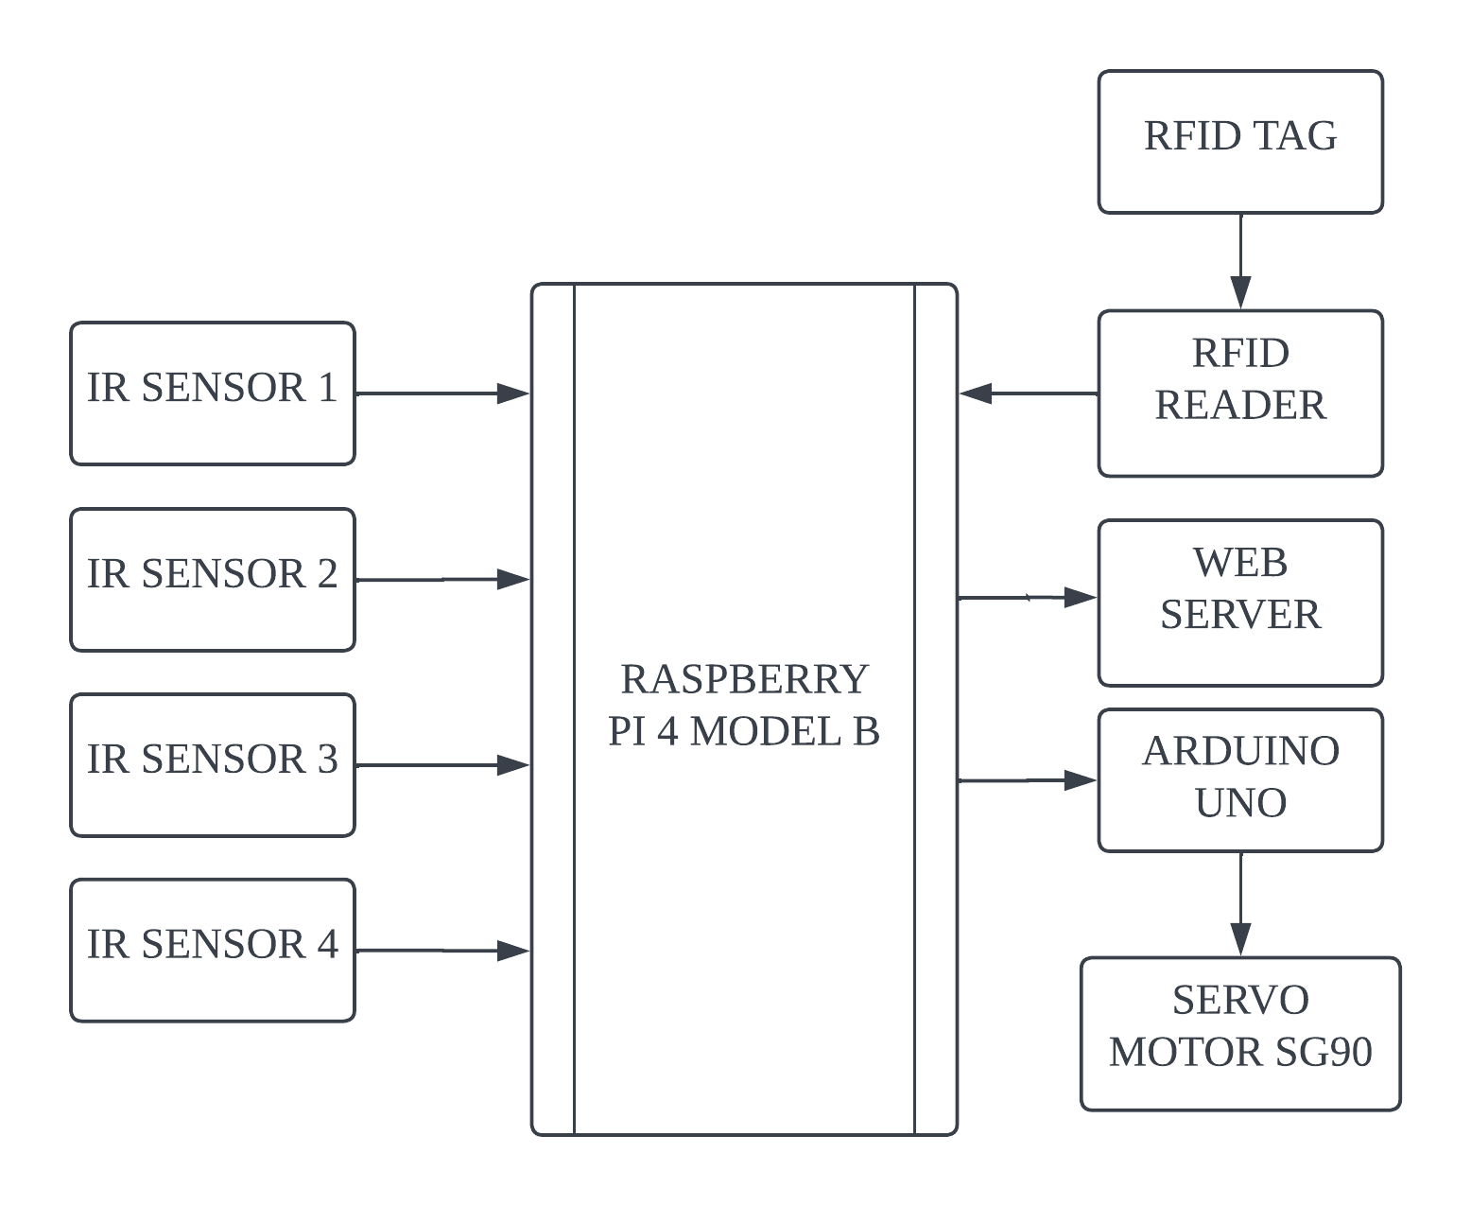
BLOCK DIAGRAM
.

Slide 12
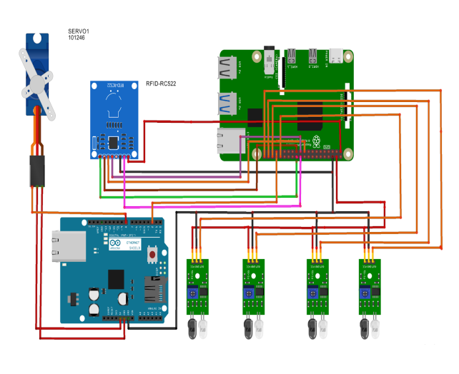
CONNECTION DIAGRAM
Connection Diagram of Proposed System

Slide 13
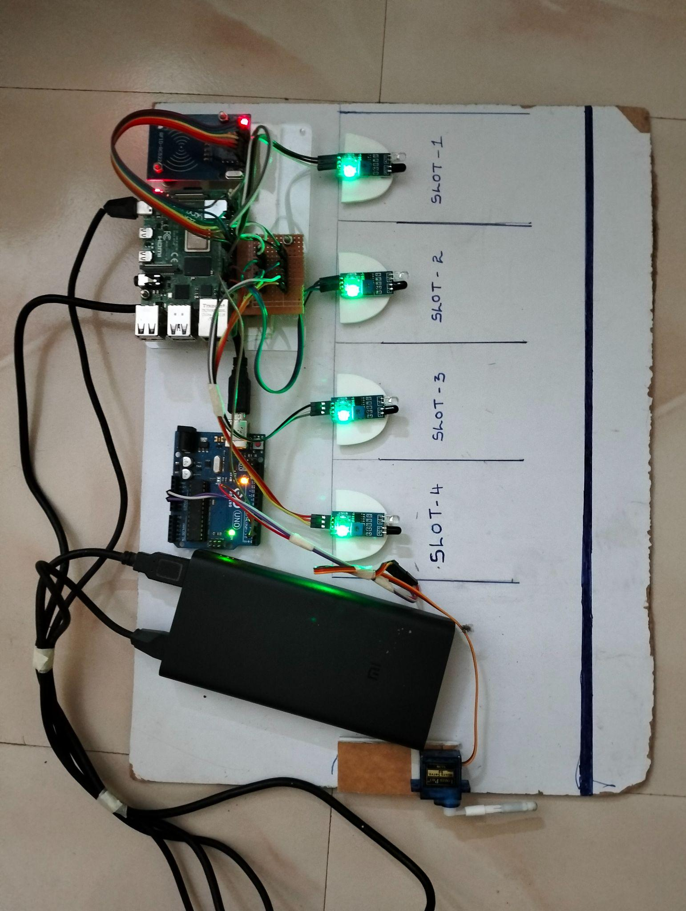
PROTOTYPE

Slide 14
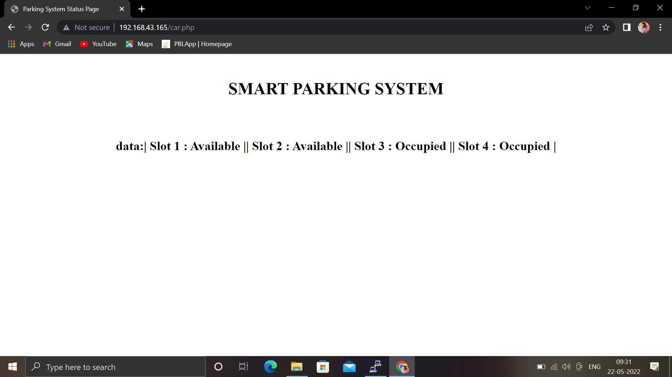
PROJECT OUTPUT
HTML page showing slot availability

Slide 15
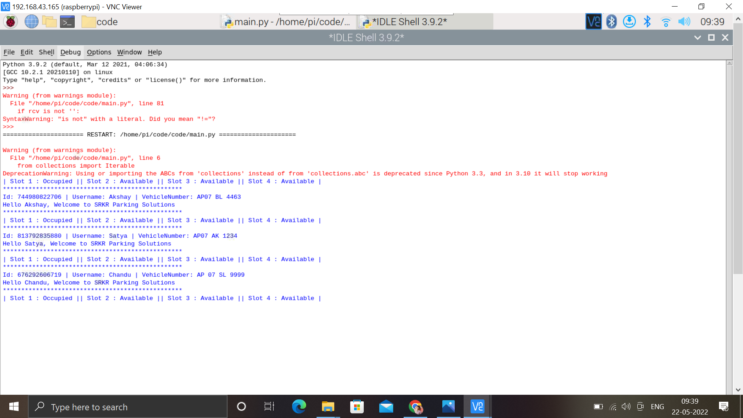
PROJECT OUTPUT
Shell output when RFID card when going into parking lot

Slide 16
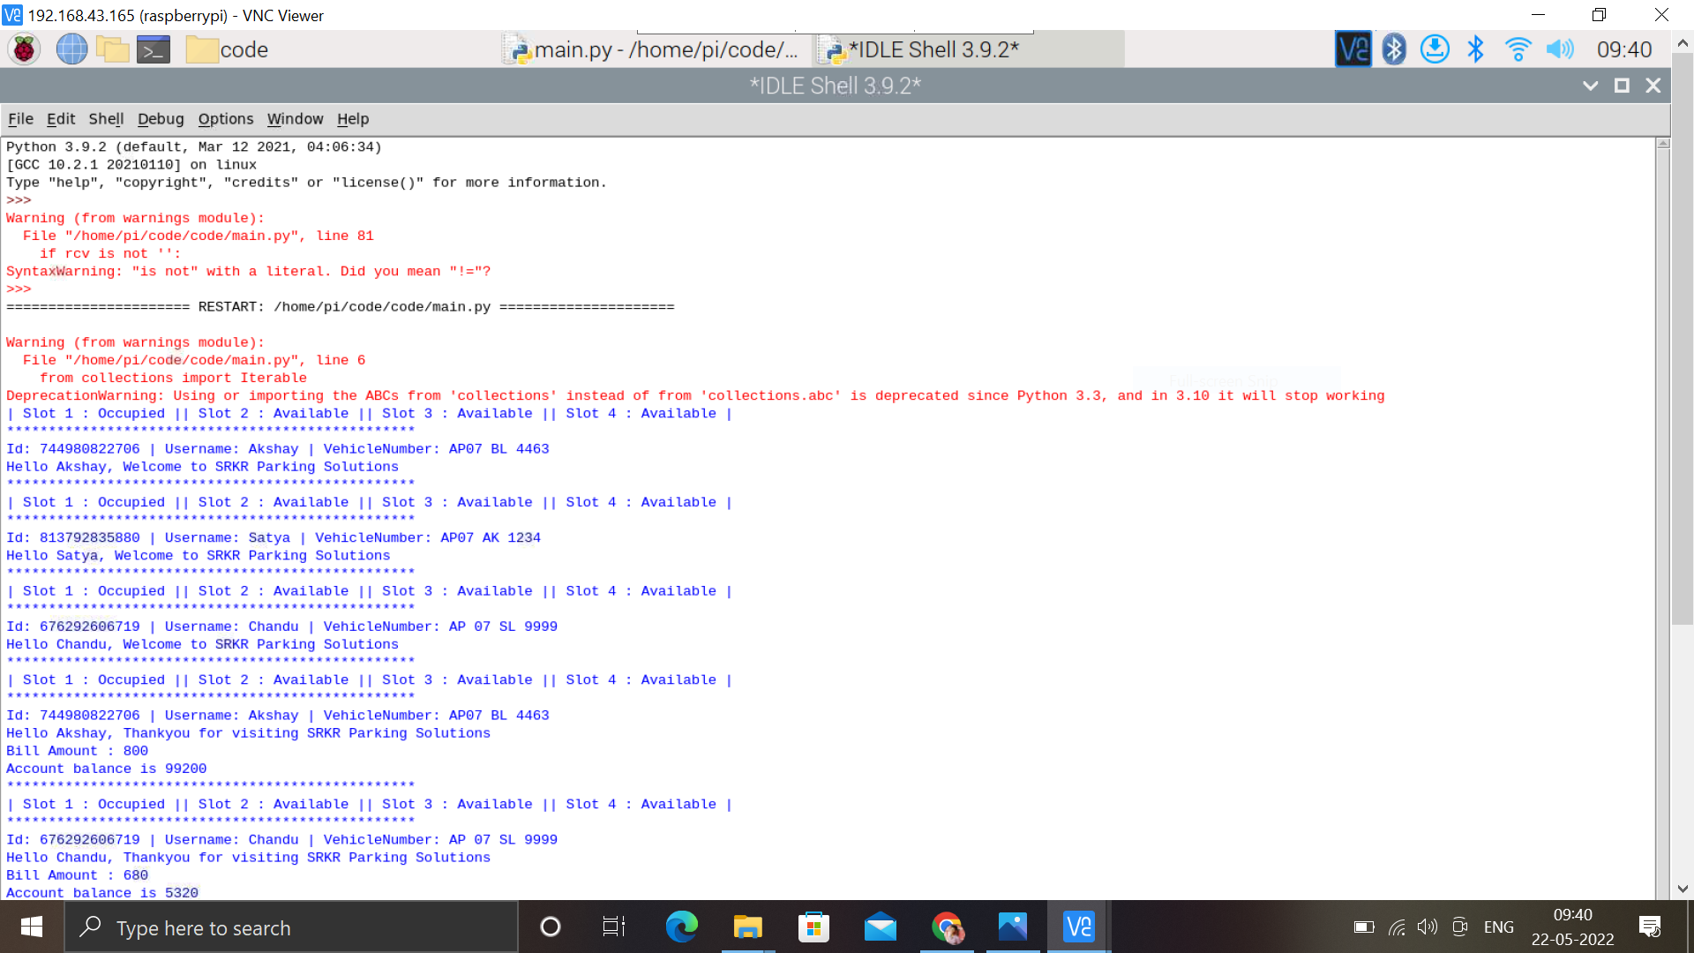
PROJECT OUTPUT
Shell output when RFID card when going out of parking lot

Slide 17
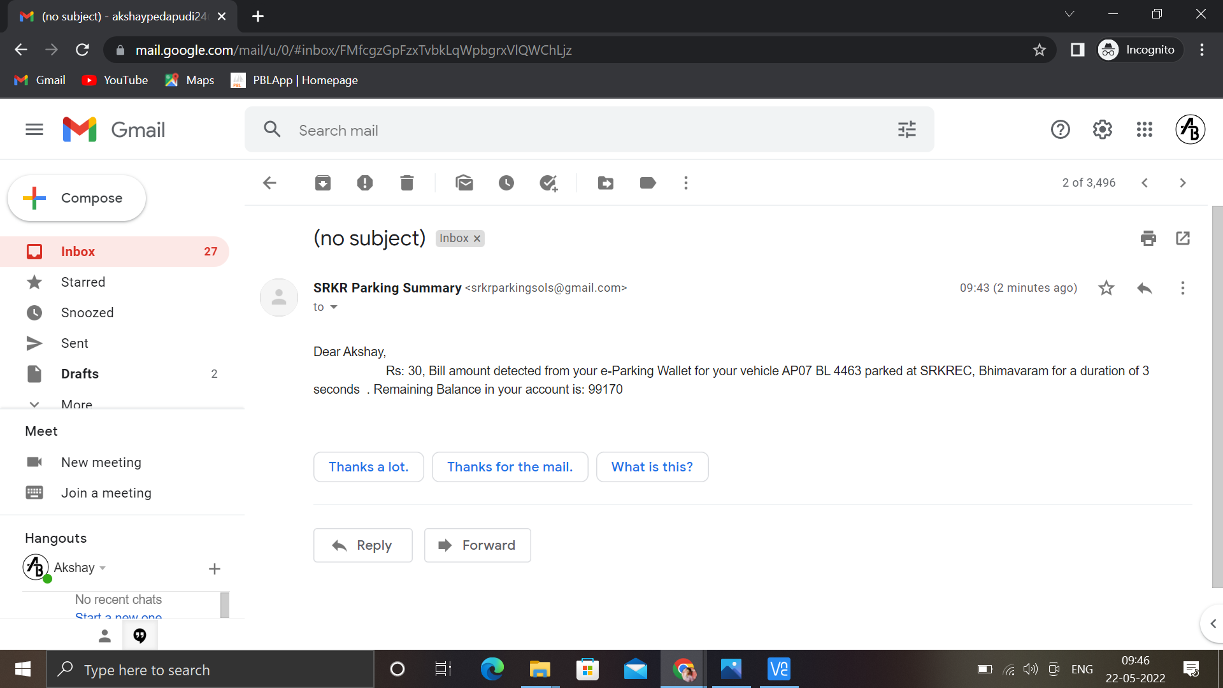
PROJECT OUTPUT
Parking bill received by the user to their mail

Slide 18
CONCULSION
With RaspBerry Pi ,Arduino UNO , R522 RFID module ,Servo motor and IR sensor module we built a reliable and secured smart parking system.By using RFID tags and a reader with a database we can develop a secure and well managed parking lot.
A successful implementation of this project would result in less traffic and chaos in crowded parking spaces like malls and business buildings where many people share a parking area.
The automated parking fee system would allow people to travel without cash. It provides drivers with Also, as it would reduce the waiting time, long queues, tension, stress and increase the efficiency of the parking system.

Slide 19
FUTURE SCOPE
The replacement of IR sensors with Ultrasonic sensors which use the sound wave for detection. As detection is Ultrasonic sensor can not be affected by many factors. Ultrasonic sensors are more reliable than IR sensors.
The next goal is a Smart parking system based on Slot booking , using the Android application, to be implemented. Using the slot allocation method we can book our own cheapest parking slot. It is an efficient one for solving parking problems, which overcomes the traffic congestion and also provides an efficient billing process.
This work could be further extended as a fully automated system using a multilayer parking method. Safety measures such as tracing the vehicle number and face recognition of the drivers so as to avoid theft & automatic billing process can also be designed

Slide 20
REFERENCE
1. “SmartParking,”http://www.happiestminds.com/whitepapers/smart-parking.pdf
2. Fengli Zhou, &Qing Li. Parking Guidance System Based on ZigBee and Geomagnetic Sensor Technology. 13th International Conference on Distributed
Computing and Applications to Business, Engineering and Science (DCABES) (Nov,2014) pages. 268-271. IEEE.
3. ”The Parking Professionals,” http://www.parking.org/.
4.Smart Parking: an Application of optical Wireless Sensor Network,Proceedings of the 2007 International Symposium on Applications and the Internet Workshops (SAINTW'07), 2007.

Slide 21
5. A Reservation-based Smart Parking System, The First International Workshop on Cyber-Physical Networking Systems, 2011.
6.Smart Parking Assist System using Internet of Things (IoT), International Journal of Control Theory and Applications, Volume 9-Number 40,2016.
7. Automated Vehicle Parking System using RFID, ITSI Transactions on Electrical and Electronics Engineering (ITSI-TEEE), Volume -1, Issue -2, 2013.
8. Prabhu Ramaswamy. IoT Smart Parking System for Reducing Green House Gas Emission. 2016 Fifth International Conference On Recent Trends In Information Technology.

Slide 22
THANK YOU

